Slide 1


Sleep disorder prediction present by:- Dhruvil sheladiya

Slide 2
Agenda
Introduction
Problem statement
Goals and objectives
Insights
Recommendations

Slide 3
Introduction
This project focuses on analyzing the sleep disorders of patients to gain insights into their prevalence, causes, and impacts. Sleep disorders are increasingly recognized as significant health issues affecting a large portion of the population. Through this analysis, we aim to contribute to the understanding and management of these disorders, ultimately improving the quality of life for those affected.

Slide 4
Problem Statement
This project is aimed at addressing the lack of comprehensive data analysis and understanding of sleep disorders among patients. Despite the prevalence of these disorders, there is a gap in knowledge regarding their specific types, factors influencing their development, and effective methods for their diagnosis and treatment. This project seeks to fill that gap by providing a detailed analysis of sleep disorders based on available patient data.

Slide 5

Goals and Objectives​
The primary goal of this project is to analyze the dataset on sleep disorders to identify patterns, correlations, and factors associated with different types of sleep disorders. Specifically, we aim to:
Identify the most common types of sleep disorders present in the dataset.
Develop predictive models to help diagnose specific sleep disorders based on patient data.
Provide insights and recommendations for healthcare professionals to improve the diagnosis and treatment of sleep disorders.

Slide 6
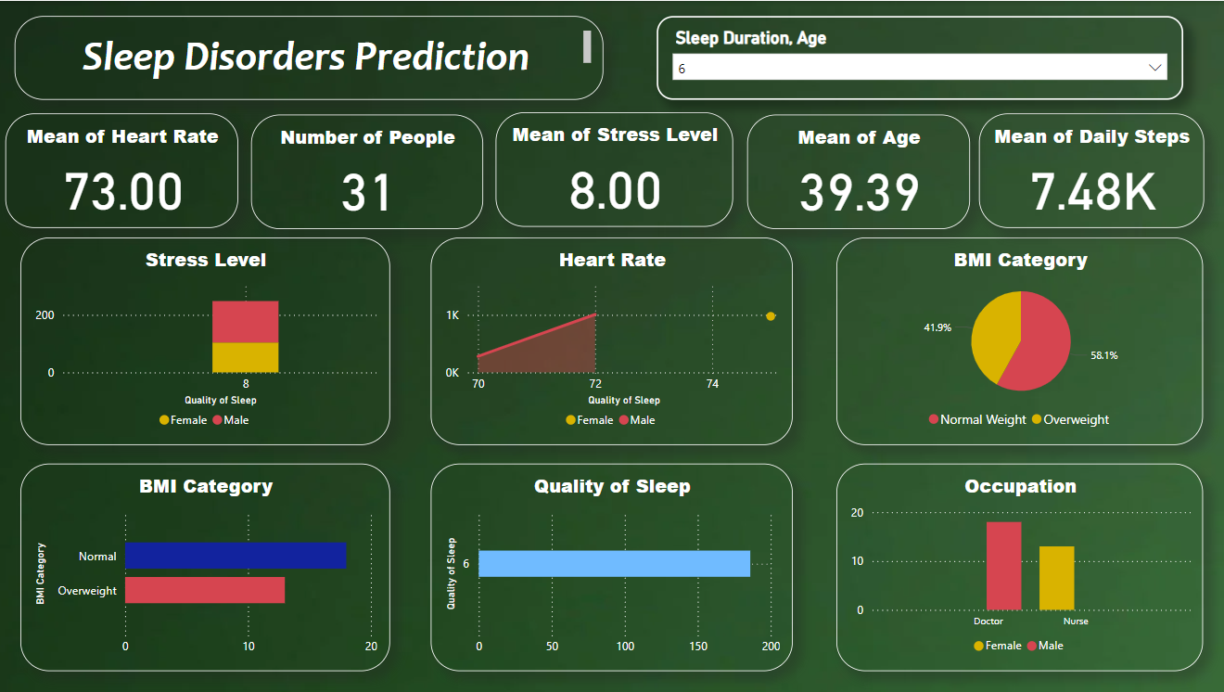
Overview

Slide 7
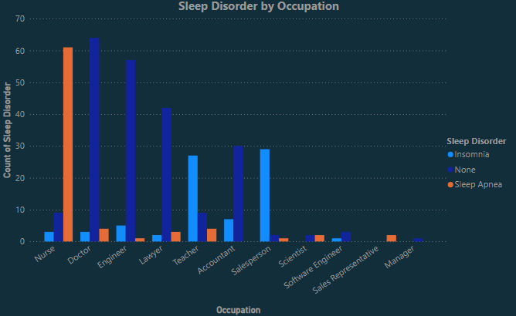
individuals with sleep disorders in different occupation categories?

Slide 8
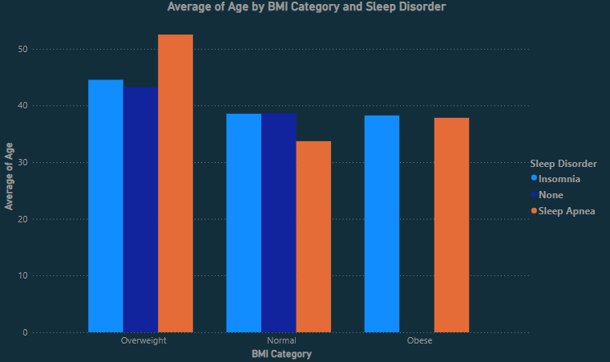
Average age group​ by BMI and sleep disorder

Slide 9
insights
Sleep Apnea
Sleep apnea is a common sleep disorder characterized by pauses in breathing or shallow breathing during sleep.
Untreated sleep apnea can lead to serious health issues such as high blood pressure, heart disease, stroke, diabetes, and depression.
Insomnia
Insomnia is a sleep disorder characterized by difficulty falling asleep or staying asleep, or waking up too early and not being able to get back to sleep.
Chronic insomnia can lead to daytime sleepiness, irritability, and difficulty concentrating.

Slide 10
recommendations
Screening
Implement regular screening programs for sleep disorders.
Utilize validated questionnaires and screening tools to identify individuals at risk for sleep apnea and insomnia.
Education
Increase public awareness about the signs and symptoms of sleep disorders.
Provide education to healthcare providers about the latest guidelines for the diagnosis and management of sleep disorders.
Collaboration
Encourage collaboration between health sectors to ensure timely and accurate diagnosis of sleep disorders.
Develop care teams to provide comprehensive care for individuals with sleep disorders.

Slide 11
THANK YOU
Dhruvil Sheladiya
dhruvilsheladiya62@gmail.com
https://www.linkedin.com/in/dhruvil7/

